Slide 1



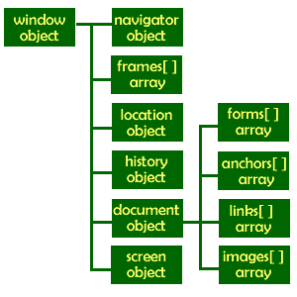

Introduction to DOM and Events
Create / Delete DOM Elements
Handle Browser Events
DOM Manipulation & Events
SoftUni Team
Technical Trainers
Software University
http://softuni.bg

Slide 2



Table of Contents
Manipulating the DOM
Create Elements
Delete Elements
Element Attributes
Event Handling
Attach / Detach Events

Slide 3
Have a Question?
sli.do #front-end

Slide 4
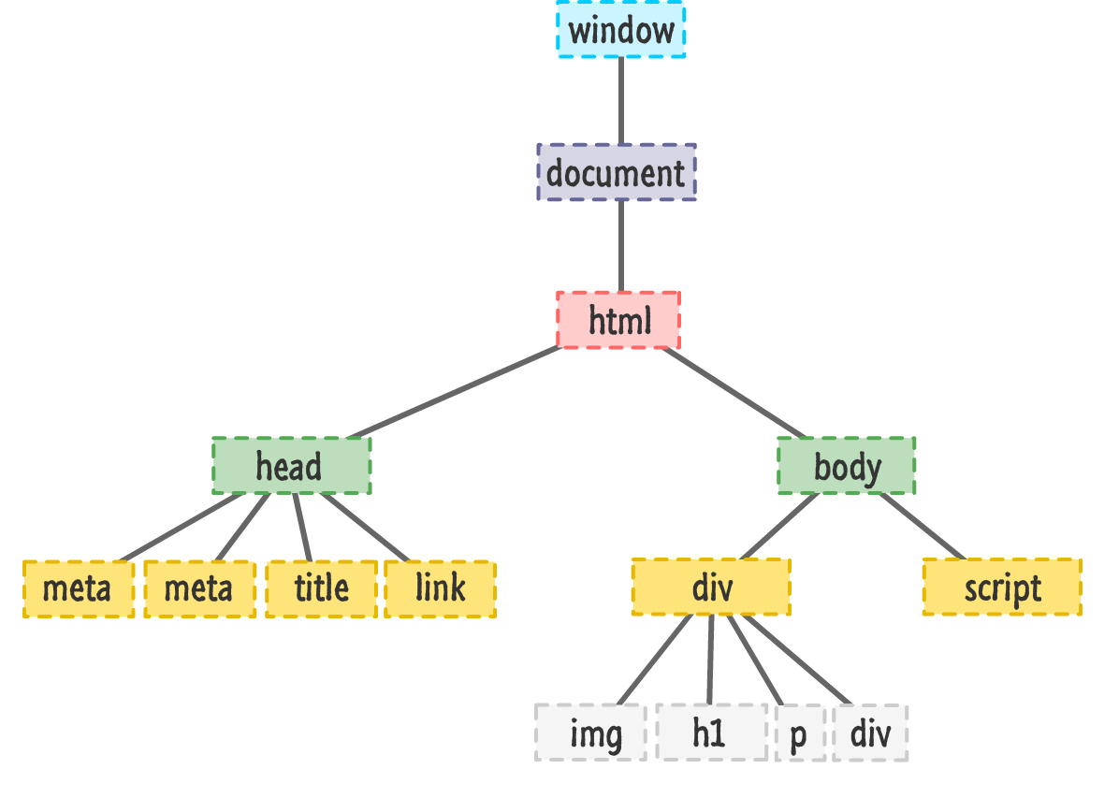
DOM Manipulation
Modify the DOM Tree

Slide 5
Creating New DOM Elements
HTML elements are created with document.createElement
This is called a Factory Pattern
Variables holding HTML elements are live:
If you modify the contents of the variable, the DOM is updated
If you insert it somewhere in the DOM, the original is moved
Text added to textContent will be escaped
Text added to innerHTML will be parsed and turned into actual HTML elements → beware of XSS attacks!

Slide 6
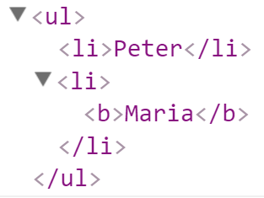
Creating New DOM Elements: Examples
let list = document.createElement("ul");
let liPeter = document.createElement("li");
liPeter.textContent = "Peter";
list.appendChild(liPeter);
let liMaria = document.createElement("li");
liMaria.innerHTML = "<b>Maria</b>";
list.appendChild(liMaria);
document.body.appendChild(list);

Slide 7
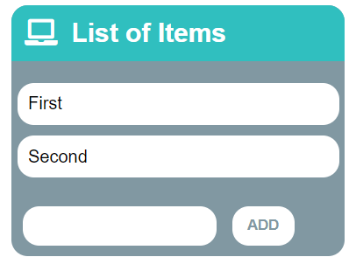
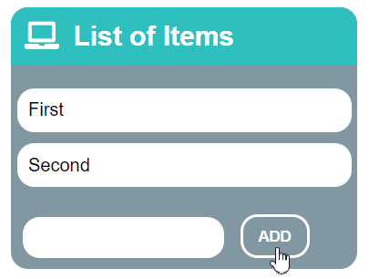
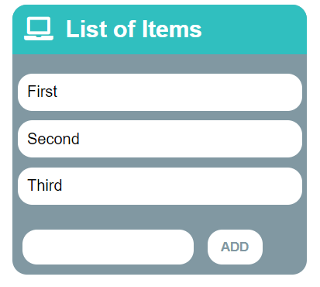
Problem: List of Items
Create a HTML page holding a list of items + text box + button for adding more items to the list
Write a JS function to append the specified text to the list

Slide 8
Problem: List of Items – HTML
<h1>List of Items</h1>
<ul id="items"><li>First</li><li>Second</li></ul>
<input type="text" id="newItemText" />
<input type="button" value="Add" onclick="addItem()">
<script>
function addItem() {
// TODO: add new item to the list
}
</script>

Slide 9
Solution: List of Items
function addItem() {
let text =
document.getElementById('newItemText').value;
let li = document.createElement("li");
li.appendChild(document.createTextNode(text));
document.getElementById("items").appendChild(li);
document.getElementById('newItemText').value = '';
}
Check your solution here: https://judge.softuni.bg/Contests/1096

Slide 10
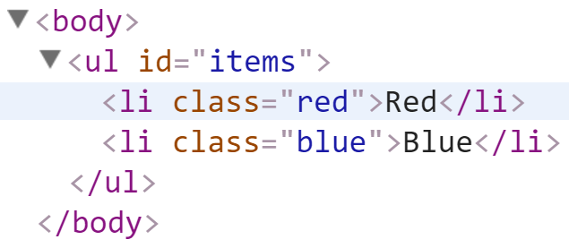
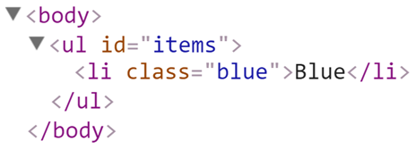
Deleting DOM Elements
<ul id="items">
<li class="red">Red</li>
<li class="blue">Blue</li>
</ul>
let redElements =
document.querySelectorAll("#items li.red");
redElements.forEach(li => {
li.parentNode.removeChild(li);
});

Slide 11
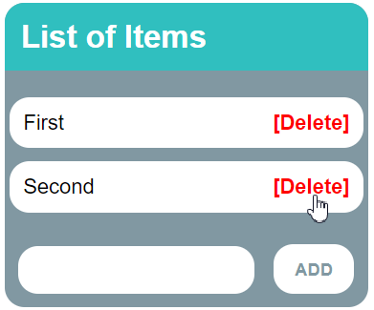
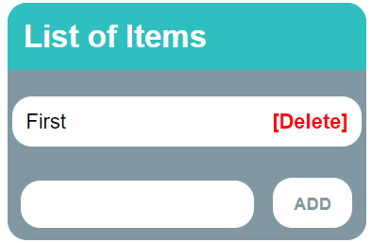
Problem: Add / Delete Items
Extend the previous problem
Implement [Delete] action as link after each list item

Slide 12
Problem: Add / Delete Items – HTML
<h1>List of Items</h1>
<ul id="items"></ul>
<input type="text" id="newText" />
<input type="button" value="Add" onclick="addItem()">
<script>
function addItem() { ...
function deleteItem() { ... }
}
</script>

Slide 13
Solution: Add / Delete Items
function addItem() {
let text = document.getElementById('newText').value;
let li = document.createElement("li");
li.appendChild(document.createTextNode(text + " "));
let span = document.createElement('span');
span.innerHTML = "<a href='#'>[Delete]</a>";
span.firstChild.addEventListener('click', deleteItem);
li.appendChild(span);
document.getElementById("items").appendChild(li);
document.getElementById('newText').value = '';

Slide 14
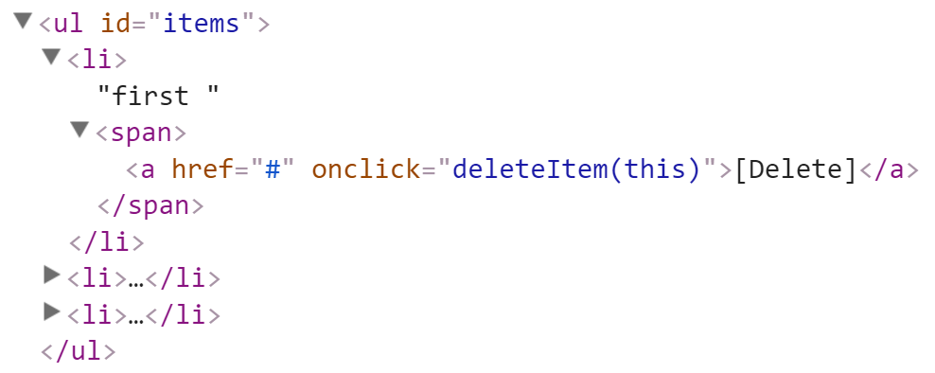
Solution: Add / Delete Items (2)
function deleteItem() {
let li = this.parentNode.parentNode;
let ul = li.parentNode;
ul.removeChild(li);
}
}
this.parentNode.parentNode == li
this.parentNode == span
this holds the clicked hyperlink
Check your solution here: https://judge.softuni.bg/Contests/1096

Slide 15
Problem: Delete from Table
<table border="1" id="customers">
<tr><th>Name</th><th>Email</th></tr>
<tr><td>Eve</td><td>eve@gmail.com</td></tr>
<tr><td>Nick</td><td>nick@yahooo.com</td></tr>
<tr><td>Didi</td><td>didi@didi.net</td></tr>
<tr><td>Tedy</td><td>tedy@tedy.com</td></tr>
</table>
<div> Email:
<label> <input type="text" name="email"/> </label>
<button onclick="deleteByEmail()">Delete</button>
<div id="result"></div></div>

Slide 16
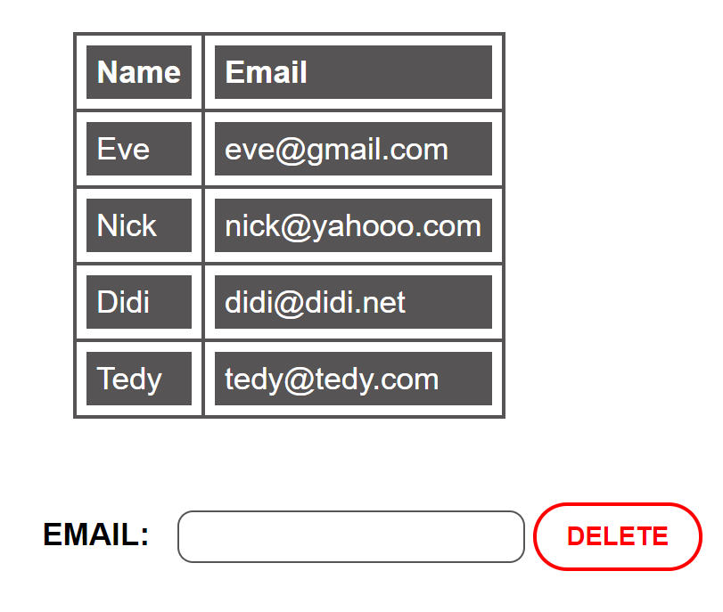
Solution: Delete from Table
function deleteByEmail() {
let email = document.getElementsByName("email")[0].value;
let secondColumn = document.querySelectorAll(
"#customers tr td:nth-child(2)");
for (let td of secondColumn)
if (td.textContent == email) {
let row = td.parentNode;
row.parentNode.removeChild(row);
document.getElementById('result').
textContent = "Deleted.";
return;
}
document.getElementById('result').textContent = "Not found.";
}

Slide 17

Practice: DOM and Events
Live Exercises in Class (Lab)

Slide 18
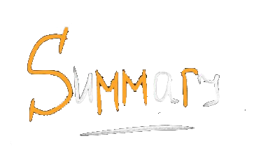

Summary
The “JavaScript for Front-End" course teaches
The first steps in JavaScript
Training curriculum
Basic Syntax, JSON, Objects, Libraries etc.
Practical exam
2 problems for 6 hours
Learning resources
Slides, videos, software, books, forum

Slide 19







JS for Front-end – Intro to DOM and Events
https://softuni.bg/courses/javascript-for-front-end

Slide 20






SoftUni Diamond Partners

Slide 21






SoftUni Diamond Partners

Slide 22
License
This course (slides, examples, demos, videos, homework, etc.) is licensed under the "Creative Commons Attribution-NonCommercial-ShareAlike 4.0 International" license

Slide 23





Trainings @ Software University (SoftUni)
Software University – High-Quality Education, Profession and Job for Software Developers
softuni.bg
Software University Foundation
http://softuni.foundation/
Software University @ Facebook
facebook.com/SoftwareUniversity
Software University Forums
forum.softuni.bg

